Slide 1

Tweet Sentiment Analysis using Graph Classification
Harrison lu
Michelle xu

Slide 2
Goal
Classify whether a tweet is positive or negative
By comparing a tweet’s individual word graph to a positive word graph and negative word graph

Slide 3
Methodology
Dataset = 1.6 million tweets already classified as positive or negative
Filter dataset using the keyword: “food” (8,440 tweets)
80% of entire dataset = training data
60% to create positive graph model and negative graph model
40% to train data mining classifiers (KNN, decision tree, regression)
20% of entire dataset = testing data
Preprocessed tweet text (removed stop words and punctuation)
Represented tweet in a graph by looking at each word and its K neighbors

Slide 4
Tweet Word Graph
Tweet: “This is a test for sentiment analysis graph mining”
Frame = 3
Adjacency List for Tweet Graph
Start Node | End Nodes
This | is, a, test
is | A, test, for
A | test, for, sentiment
Test | For, sentiment, analysis
For | Sentiment, analysis, graph
… | …

Slide 5
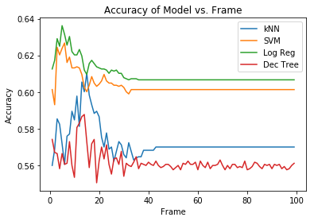
Accuracy w.r.t Frame
Log Regression: ≈ 8 frames
SVM: ≈ 8-9 frames
K-NN: ≈ 17 frames
Decision Tree: ≈ 15 frames

Slide 6
Graph Similarity Measures
Compare tweet graph against graph model by calculating positive score and negative score
Edge Similarity
number of common edges
MCS Node Similarity
number of nodes in the maximum common subgraph (MCS)
MCS Undirected Edge Similarity
Number of MCS edges, which are generated if both graphs have the same edge (undirected)
MCS Directed Edge Similarity
Number of MCS edges, which are generated if both graphs have the same edge (directed)
TF-IDF
TF-IDF score was used as representative for the entire tweet graph model

Slide 7
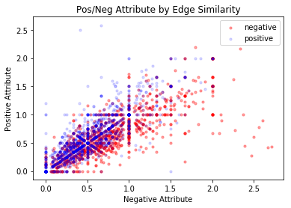
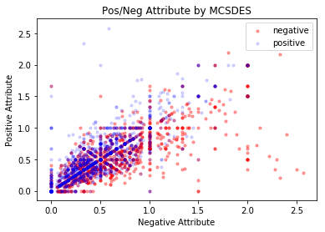
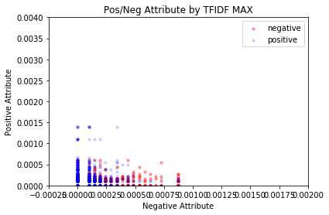
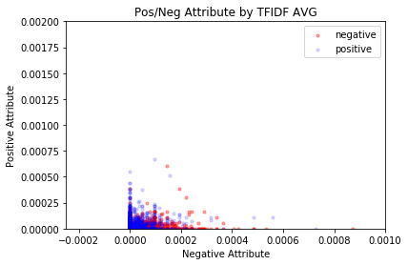
Performance of Graph Similarity Measures
Edge Similarity and MCS do not separate tweets as well as TFIDF

Slide 8
Classification Methods
K-Nearest Neighbors
Support Vector Machine (SVM) – linear kernel
Decision Tree (ID3)
Logistic Regression

Slide 9
Classification Results
 | Edge Similarity | MCSNS | MCSUES | MCSDES | Max - TIIDF | Avg - TIIDF | Mod - TIIDF
0.5% of Data | Log Regression 0.629 | SVM 0.576 | Log Regression 0.606 | Log Regression 0.606 | Decision Tree 0.628 | Decision Tree 0.595 | Log Regression 0.640
20% of Data | Log Regression 0.649 | Log Regression 0.594 | Log Regression 0.627 | Log Regression 0.627
50% of Data | Log Regression 0.643 | Decision Tree 0.584 | Log Regression 0.626 | Log Regression 0.626

Slide 10
Flashback: 427s Homework Sentiment Analysis
Sentiment Analysis using Hive:
63.16%
Graph Classification Model:
90.40%

